Slide 1
Large-Scale and Multi-Structured Databases
Project Design
MyFuture
Alessandro Diana

Slide 2
Application Highlights
MyFuture is a trading web application that provides access to a wide range of financial assets, including stocks, ETFs, and cryptocurrencies.
The platform allows users to manage their personal account and investment portfolio, enabling them to view, buy, and sell the available assets directly through the app.
Users can track their open positions, transactions, and account balance in real time.
In addition, MyFuture offers a section dedicated to financial news and market updates, helping users stay informed and make better investment decisions.
Summary:
User can browse the assets;
User can visualize plot of assets prices;
User can buy and sell assets;
User can browse the news;
Admin can update, add, or remove assets;
Admin can modify and suspend user accounts.
Admin can calculate analytics.

Slide 3
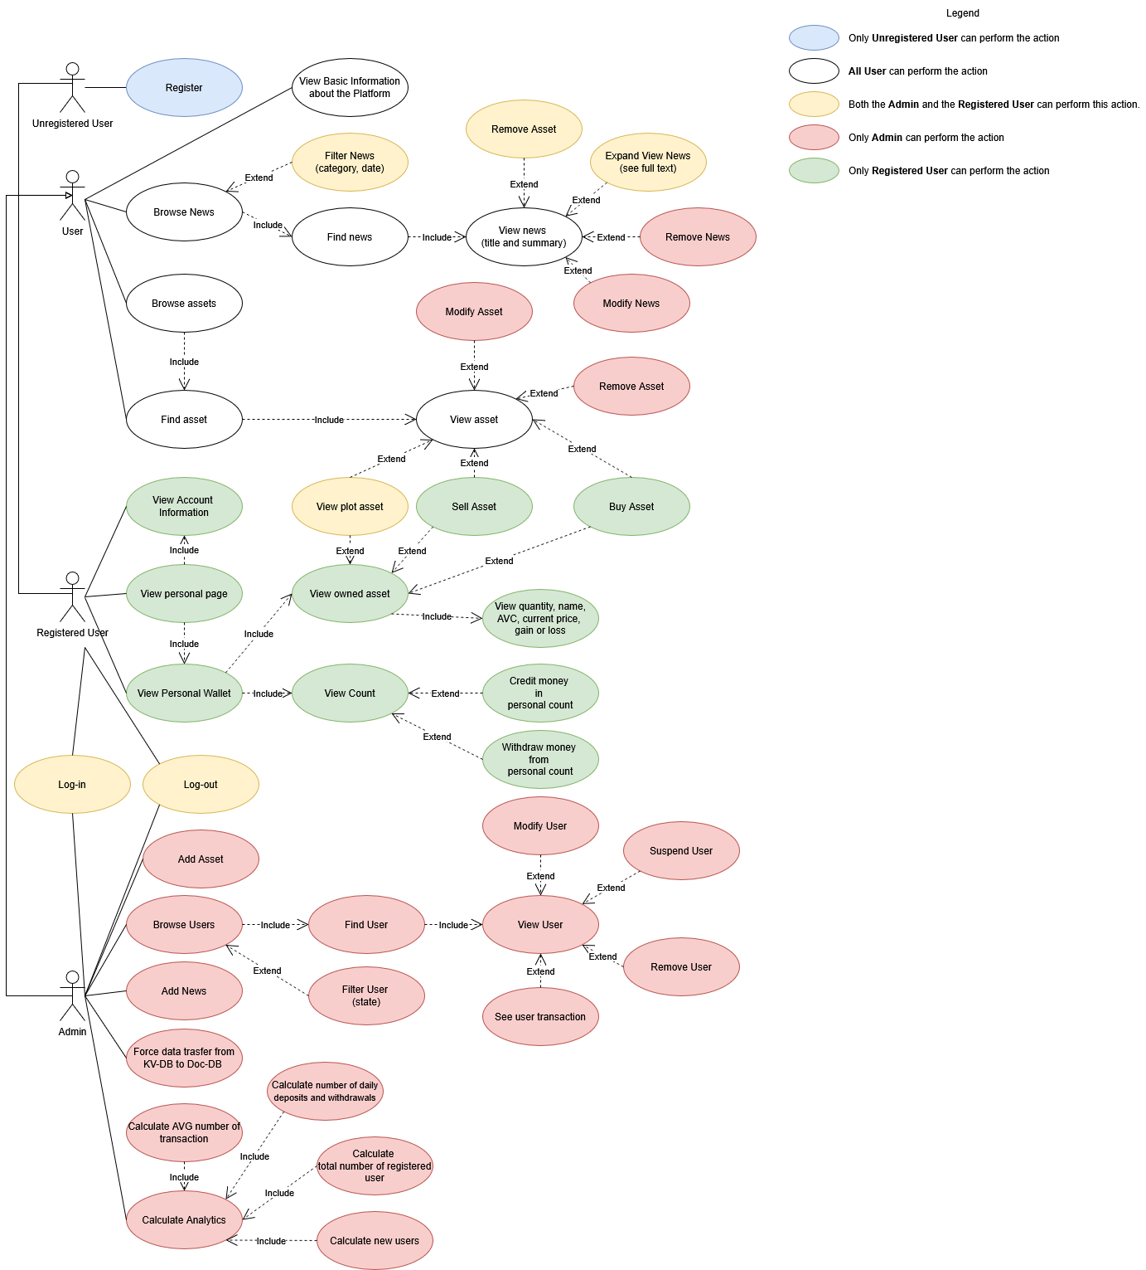
Actors and Use cases
Main actors:
Unregistered User: can browse the platform and access basic features.
However, they cannot perform trading actions or manage a personal portfolio.
Registered User: has full access to the trading functionalities.
They can view detailed asset data, buy and sell financial assets, manage their portfolio, and track their account balance within the platform.
Admin: is responsible for managing the platform’s data and users.

Slide 4
Mock-ups (0)
Home page

Slide 5

MyFuture
Trading | About us
Apri un conto
Log In
Apri un conto
Assets
Explore a variety of Shares, ETFs and Crypto with real time prices and invest on what you like.
Apri un conto
News
Find out the lates news in the market and discover the hottest trends.
Notes:
Esempio di possible homepage

Slide 6
Mock-ups (1)
Wallet Overview

Slide 7
Account Overview
Balance 0$ | Available to Trade 0$
Portfolio 0$ | Total P/L 0$
Shares
PRODUCT | SYMBOL|ISIN | QTY | PRICE | CURR. | VALUE | BEP | P/L $
Tesla, Inc. | TSLA | 10 | $447,86 | USD | 4470,6 | 430 | +6,8
NVIDIA Corporation | NVDA | 50 | $196,85 | USD | 9842,5 | 200 | -35
B
S
B
S
Trackers (ETFs)
PRODUCT | SYMBOL|ISIN | QTY | PRICE | CURR. | VALUE | BEP | P/L $
iShares Core MSCI World UCITS ETF USD | SWDA | 15 | $114,44 | USD | 1716,6 | 120 | +12,8
B
S
Notes:
Pagina personale

Slide 8
Mock-ups (2)
Asset Plot

Slide 9
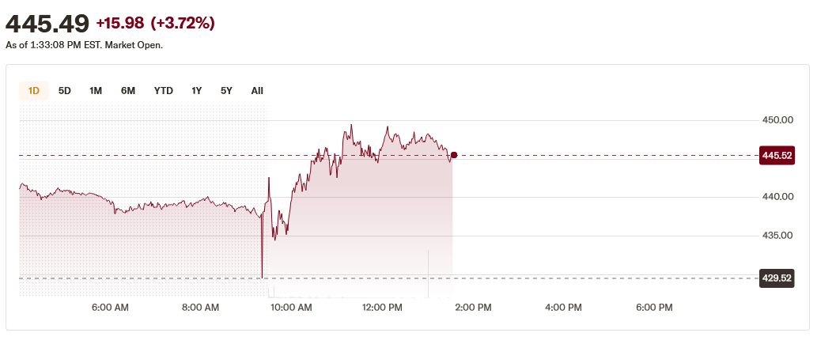
MyFuture
Trading | About us
Apri un conto
Log In
Shares
PRODUCT | SYMBOL|ISIN | QTY | PRICE | CURR. | VALUE | BEP | P/L $
Tesla, Inc. | TSLA | 10 | $447,86 | USD | 4470,6 | 430 | +6,8
B
S
Notes:
Pagina personale

Slide 10
Mock-ups (3)
Asset List (Shares)

Slide 11
MyFuture
Trading | About us
Apri un conto
Log In
Shares
ETFs
Cryptos
Shares
PRODUCT | SYMBOL |  | PRICE | VAR | ACTION
Tesla, Inc. | TSLA |  | $430,63 | 6,80
NVIDIA Corporation | NVDA |  | $984,88 | 35,00
Airbnb, Inc. | ABNB |  | $105,57 | 10,00
Coca-Cola Company (The) | KO |  | $60,95 | 0,29
Intel Corporation | INTC |  | $30,88 | 0,50
Pfizer, Inc. | PFE |  | $21,68 | 0,77
Netflix, Inc. | NFLX |  | $96,16 | 3,04
T-Mobile US, Inc. | TMUS |  | 186,00 | 0,18
Walt Disney Company (The) | DIS |  | 91,38 | 0,15
Western Digital Corporation | WDC |  | 157,83 | 0,67
B
S
B
S
B
S
B
S
B
S
B
S
B
S
B
S
B
S
B
S

Slide 12
Mock-ups (4)
Asset List (ETF)

Slide 13
MyFuture
Trading | About us
Apri un conto
Log In
Shares
ETFs
Cryptos
ETFs
PRODUCT | SYMBOL |  | PRICE | VAR | ACTION
Vanguard S&P 500 ETF | VOO |  | $110,32 | 0,18
iShares Core MSCI EAFE ETF | ITOT |  | $88,62 | 0,19
Invesco S&P 500 Equal Weight ETF | RSP |  | $54,55 | 0,08
iShares iBoxx $ Investment Grade Corporate Bond ETF | LQD |  | $110,30 | 0,23
Vanguard Real Estate ETF | VNQ |  | $89,59 | 0,19
Vanguard High Dividend Yield ETF | VYM |  | $141,01 | 0,24
Schwab U.S. Broad Market ETF | SCHB |  | $25,82 | 0,06
B
S
B
S
B
S
B
S
B
S
B
S
B
S

Slide 14
Dataset Description
Source:
  Assets history collected via script using Yahoo Finance
  News from Kaggle
  https://www.kaggle.com/datasets/pratyushpuri/financial-news-market-events-dataset-2025
  https://www.kaggle.com/datasets/aravsood7/sentiment-analysis-labelled-financial-news-data
  https://www.kaggle.com/datasets/sayelabualigah/high-quality-financial-news-dataset-for-nlp-tasks?select=dataset.csv
  Transaction from Kaggle
  https://www.kaggle.com/datasets/mahmoudshaheen1134/trades-dataset
Description: The dataset used in MyFuture combines historical price data of various financial assets, transaction, and a set of financial news articles.
Volume: 1625 assets (964,8MB), 39222 transaction (1,45MB), 5263 news (9,88MB)
Variety: The dataset integrates information from different and heterogeneous sources (Yahoo Finance and Kaggle) with diverse attributes and formats.
Velocity/Variability: assets current prices collect continuously.

Slide 15
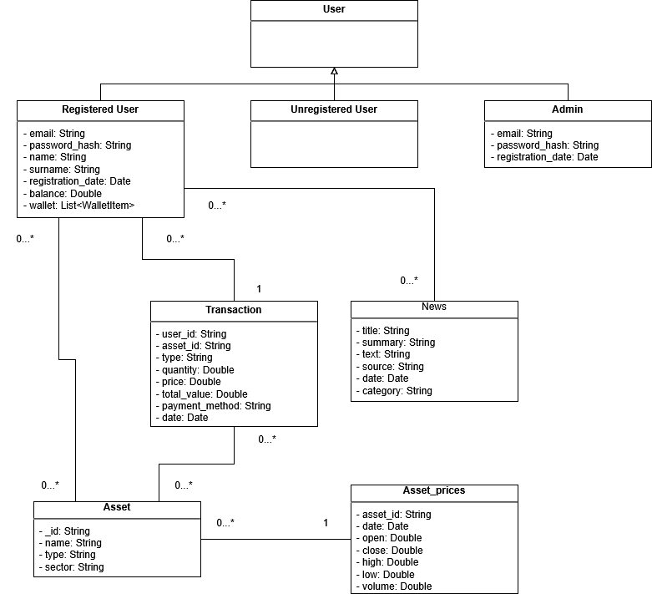
Preliminary UML Class Diagram

Slide 16
Relevant Queries and Entities handled by Document DB
Entities:
  User
  Asset
  Asset_price
  Transaction
  News
Requirements:
  View the top 10 assets with the best growth or worst decline over the past day or week;
  View the top 10 most traded assets on the platform;
  Analyze the number of transaction, by categories, over time;
  Analyze the number of transactions by payment type.
  View the total amount of money invested in assets over a specific time range (e,g, week, month, …).
  Visualize the positive or negative financial flow generated by buy/sell operations within a selected time period (e.g. week, month, …).

Slide 17
Relevant queries and Entities handled by Key-Value DB
Entities:
  User
  Asset
  Asset_price
  Transaction
  News
Requirements:
  Add real-time asset price
  Update last-time asset price
  See daily history price for assets
  Get assets list and their information
  Get latest k news

